Slide 1

MBE 713 Fisheries stock assessment using surplus production models
Elizabeth A. Babcock
Marine Biology and Ecology

Slide 2
Fisheries stock assessment
Fit population dynamics models to data including:
catch, abundance trend data, size of fish in the catch
To estimate
sustainable catch level, current biomass relative to unfished (depletion), and F and B relative to targets
Project model into the future under management strategies
Catch, effort controls, etc.
Models include uncertainty in parameters as well as process error

Slide 3
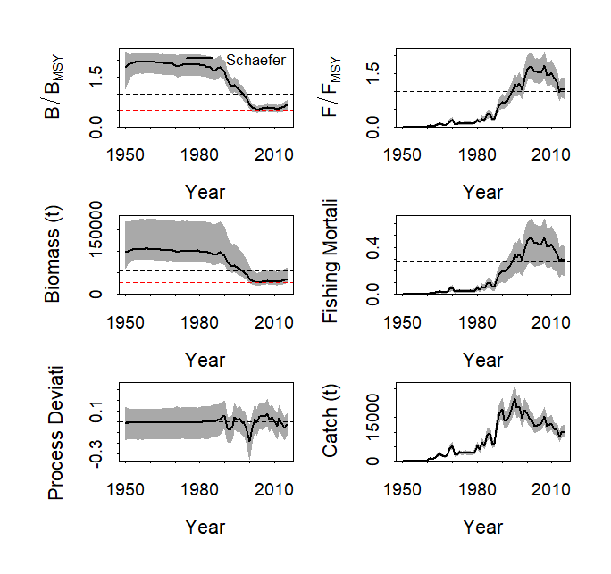
B/Bmsy and F/Fmsy

Slide 4
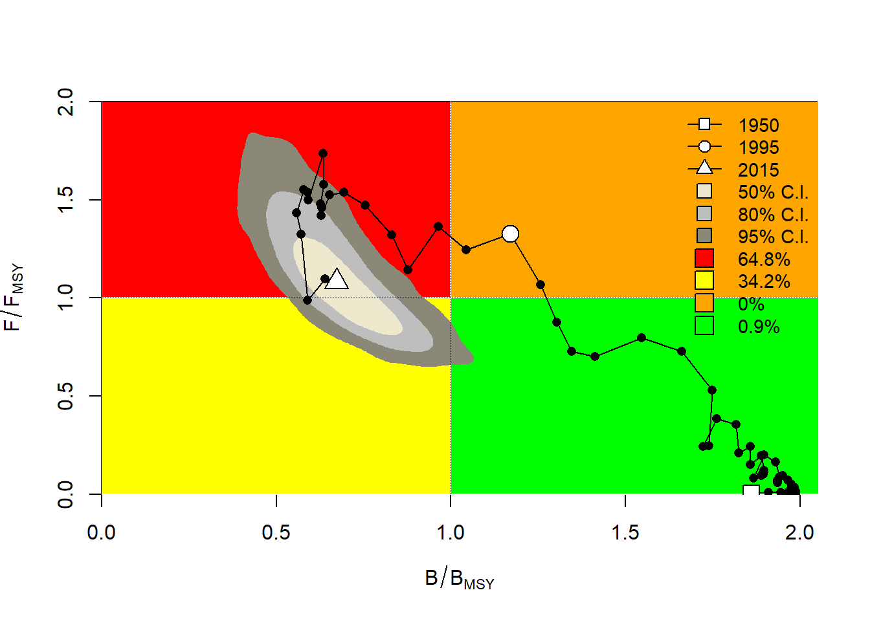
Kobe plot

Slide 5
Surplus production model
Simplest population dynamics model used for stock assessment
Often used in data poor fisheries, where size or age composition data is lacking

Slide 6
Schaefer surplus production model
r is the rate of increase at low population size
K is the unfished population size
Biomass B is latent state

Slide 7
Surplus production model yield curve
r is the rate of increase at low population size
K is the unfished population size
Biomass B calculated

Slide 8
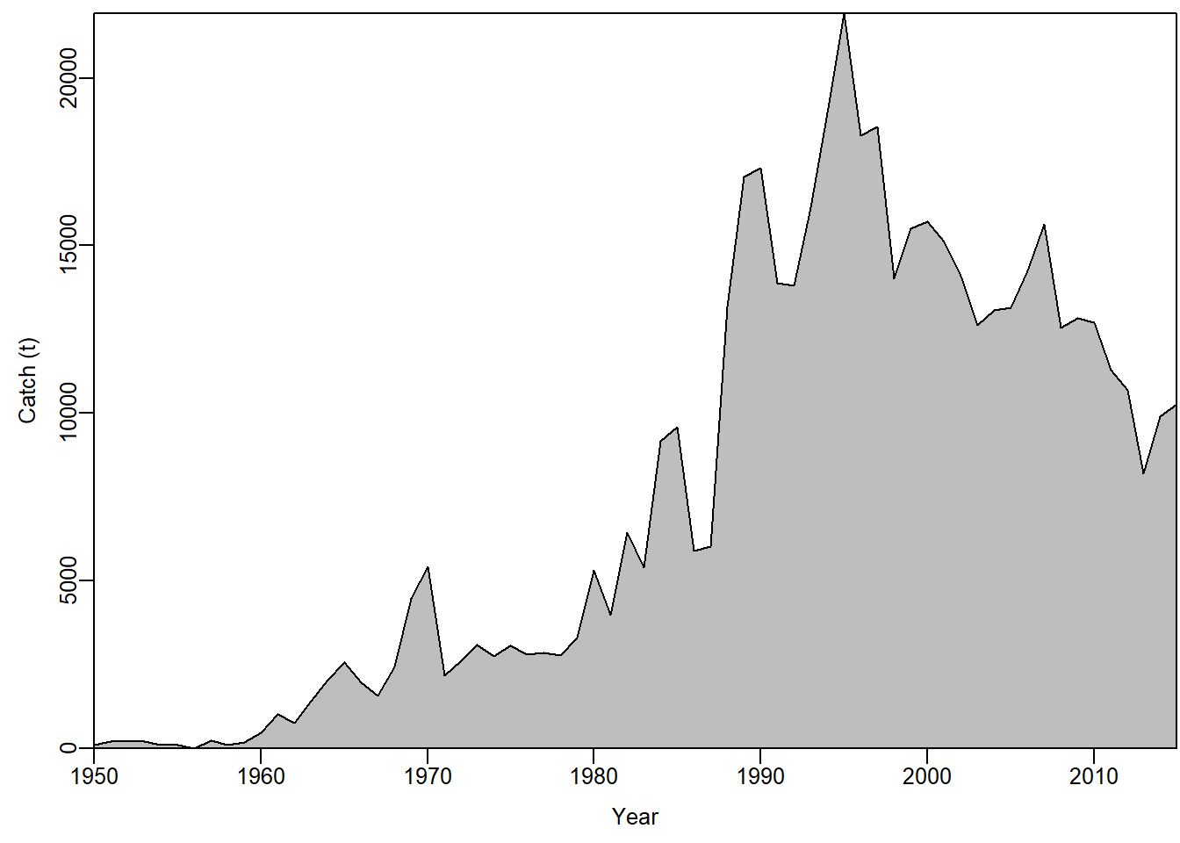
Swordfish south Atlantic catch
JABBA demo

Slide 9
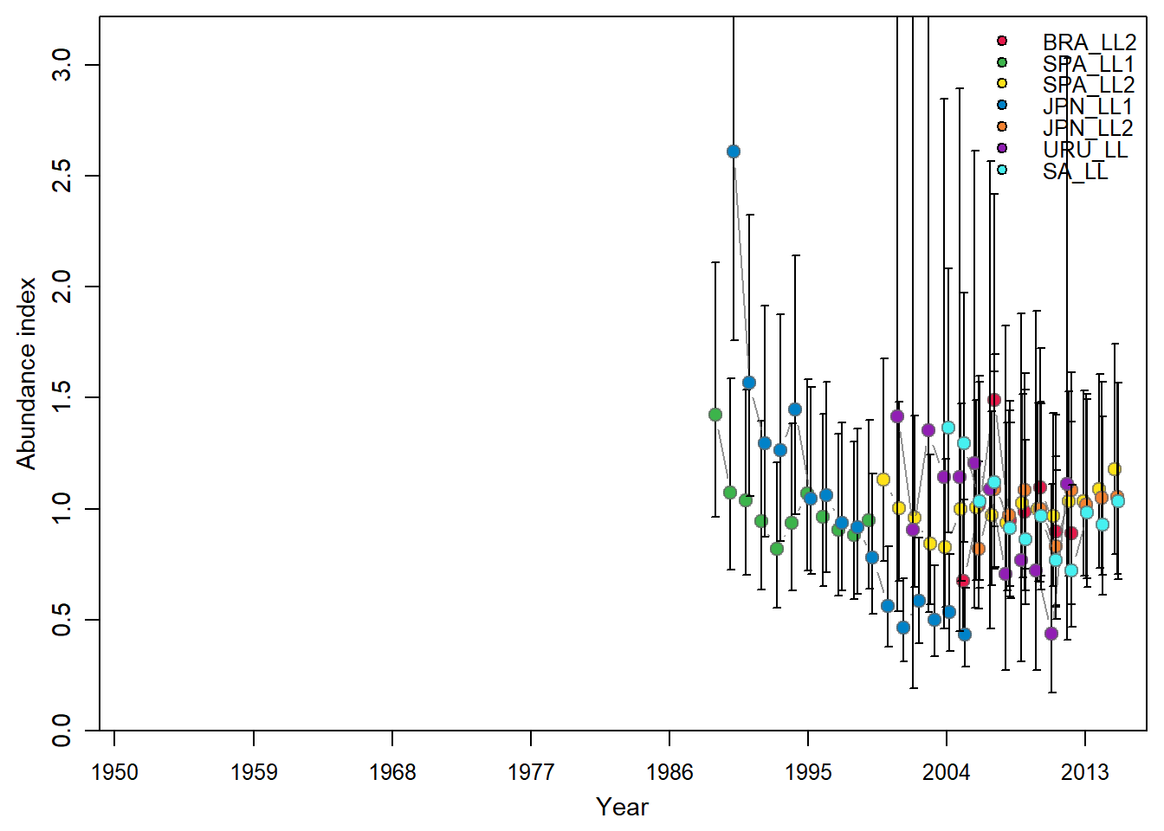
Swordfish south Atlantic CPUE

Slide 10
Deterministic version
State variable Biomass (B) is:
Assume CPUE index (I) is proportional to B
Likelihood is
Parameters with priors: r, K, B in the first year and σ_{j}² and q_{j} for each series.
Sigma σ is called Observation error
I_{j} ~lognormal(q_{j}B_{t} , σ)

Slide 11
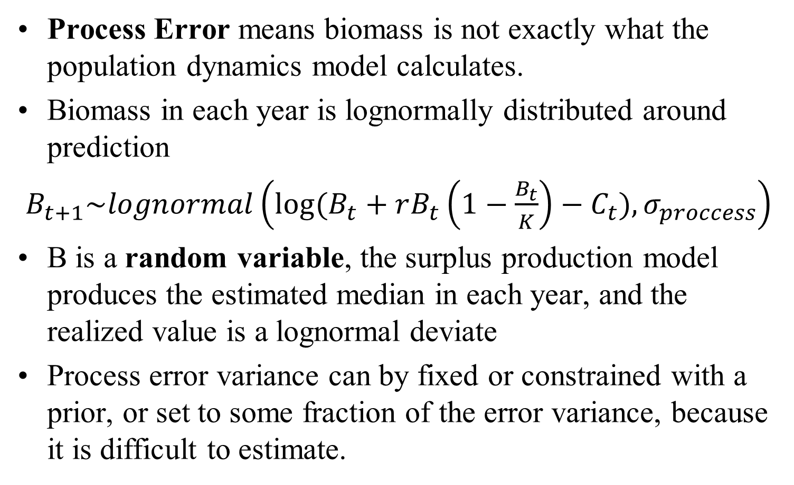
Adding process error to state variable
Process Error means biomass is not exactly what the population dynamics model calculates.
Biomass in each year is lognormally distributed around prediction
$B_{t+1}\sim lognormal\left(log⁡(B_{t}+rB_{t}\left(1−\frac{B_{t}}{K}\right)−C_{t}), σ_{proccess}\right)$
B is a random variable, the surplus production model produces the estimated median in each year, and the realized value is a lognormal deviate
Process error variance can by fixed or constrained with a prior, or set to some fraction of the error variance, because it is difficult to estimate.

Slide 12
Bayesian estimation
Bayesian statistics use prior information to constrain the values of parameters in plausible bounds
Most modern fisheries stock assessment models do this is some way, because we have biological information
K and r must be in a range of plausible values, or the population would be either extinct or exploding in size

Slide 13
Bayesian estimation
Bayesian models define parameter uncertainty as a probability density function (pdf).
The pdf of a parameter before the model is fitted to data is called the prior
The priors are multiplied by the likelihood of the data given the parameters to get the posterior
Posterior=prior*likelihood

Slide 14
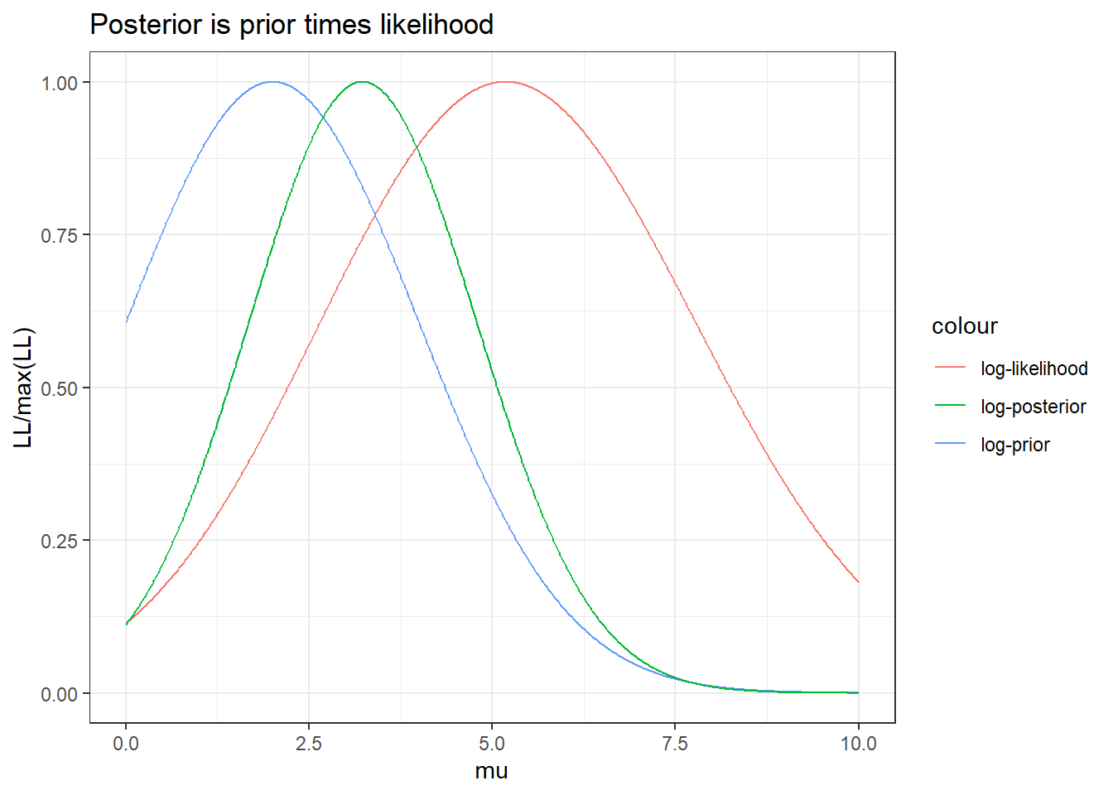
Example to estimate a normal mean with informative prior

Slide 15
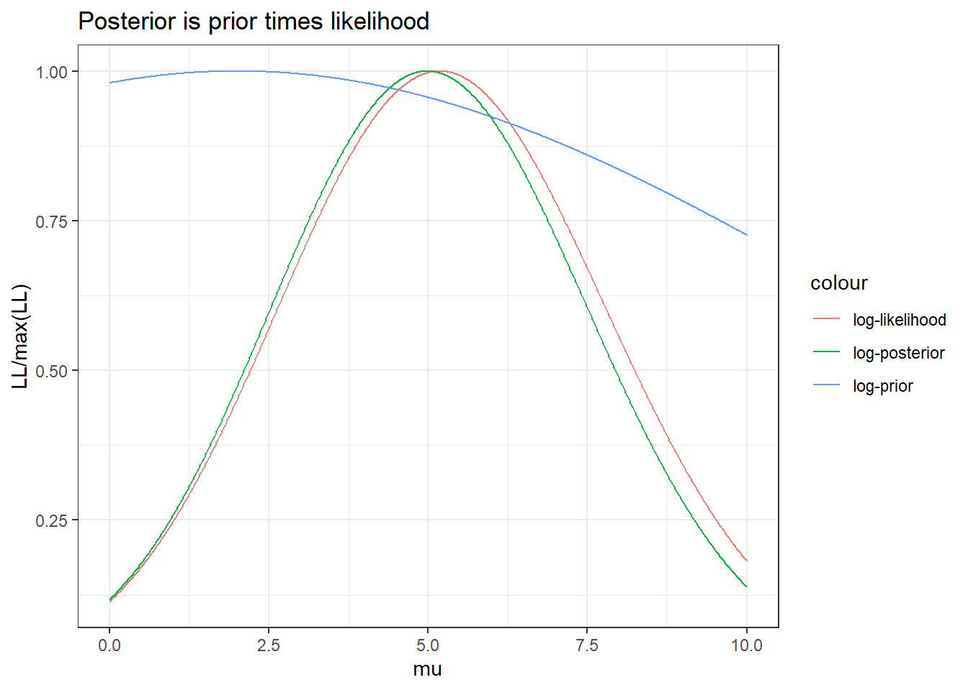
With a vague prior

Slide 16

In log terms
Log-posterior of parameters is
log(posterior) = log(prior) + log(likelihood)
$$\log\left(P\left(θ | y\right)\right)=\log\left(P\left(θ\right)\right)+P\left(y | θ\right)$$

Slide 17
Bayesian production model
Log-posterior of parameters is
log(posterior) = log(likelihood)+log(Prior-r) +log(Prior-K)+log(Prior-B0/K)+log(Prior-q) +log(prior-sigma)
Calculations are done using a numerical integration process called Markov Chain Monte Carlo (MCMC)
For Bayesian models
define the priors.
Make sure MCMC has converged on the final posterior distribution

Slide 18
Bayesian workflow
Define the model setup
Distributions to use for likelihood and priors
Prior mean and sd values, MCMC settings
Run MCMC and check for convergence
Parameter estimates should oscillate around mean in each MCMC chain, smooth posterior density plots
Check for model fit and adequacy
Residuals, posterior predictive checks, etc.
Use a sample from the posterior (called MCMC draws) to calculate posterior density plots, means, standard deviations, quantiles, etc.
Project into the future

Slide 19
Kinds of priors
Vague or diffuse, widely distributed so they don’t influence the output much
Informative, based on data such as
Population biology (number of births, deaths, etc.)
Information on expected total magnitude of the population from catches
Comparison with other populations

Slide 20
For production model
Mean and sd for r can come from demographic analysis
K is probably not much more than 10 times the total catch over the time series
B0 is centered on K if the data go back to the beginning of the fishery
Weakly informative values for q, sigma

Slide 21
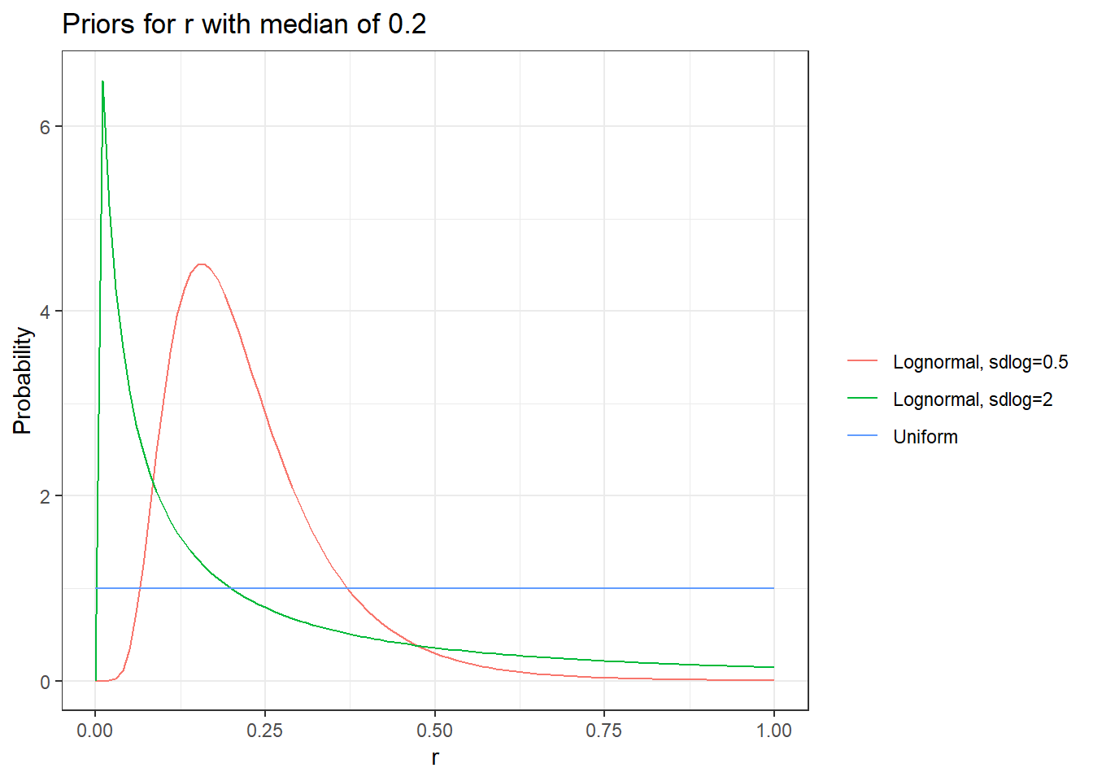

Slide 22
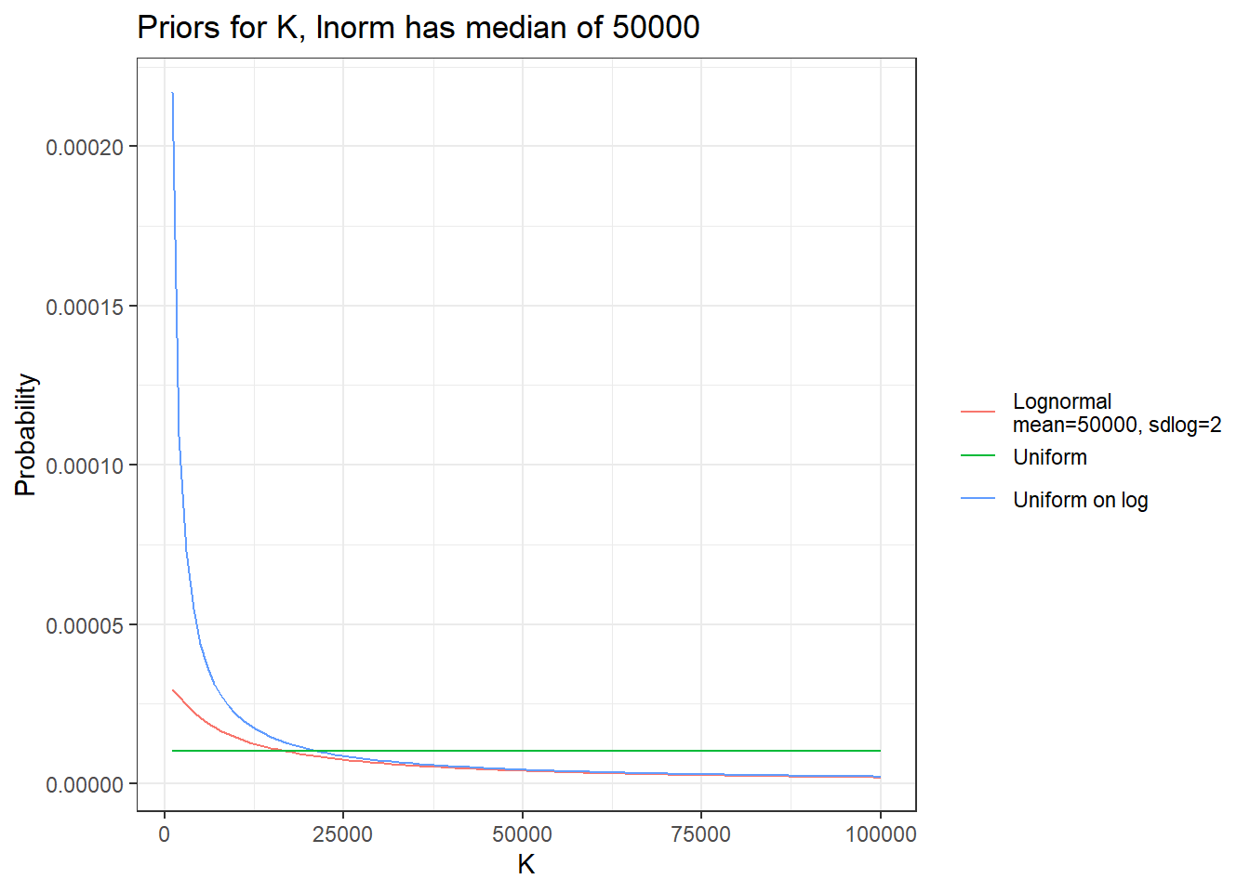

Slide 23
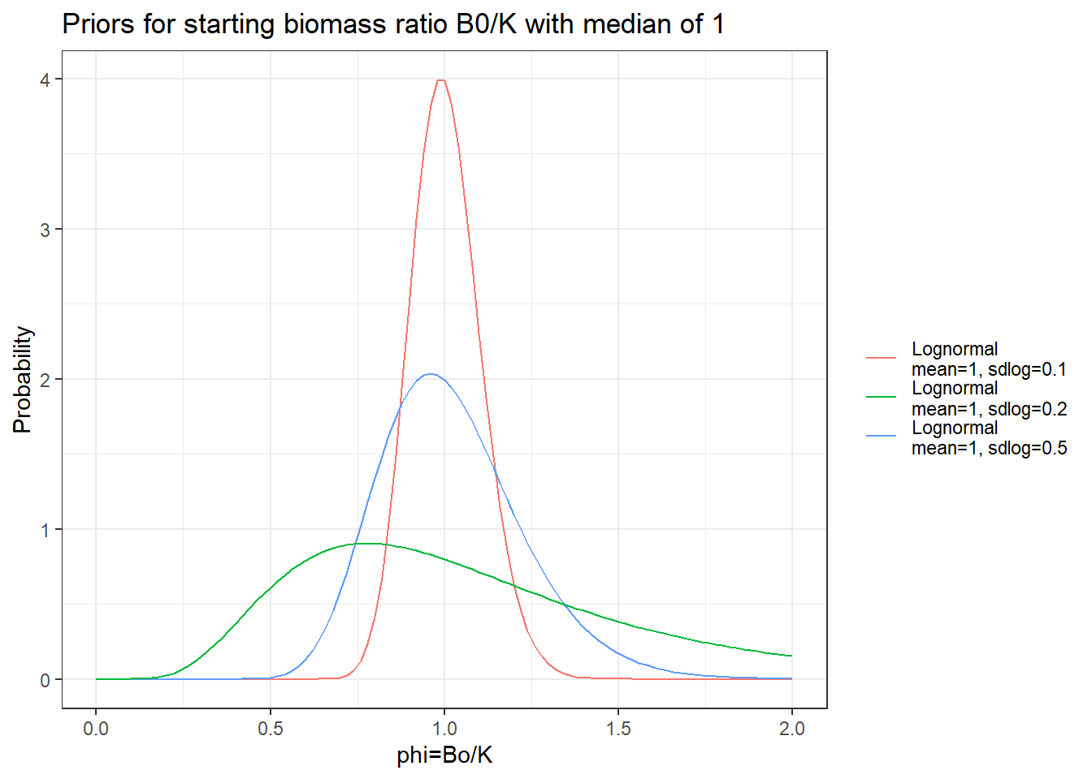

Slide 24
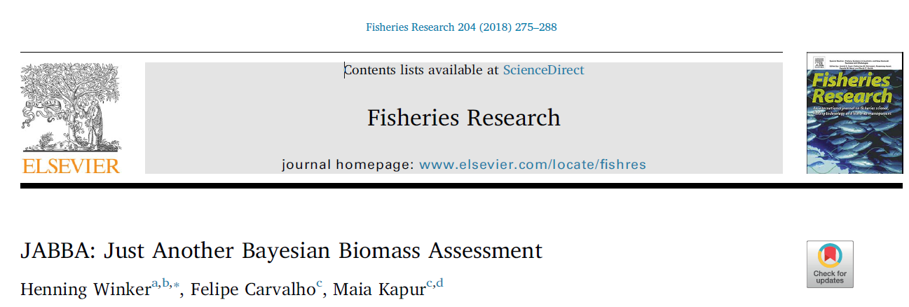
JABBA
https://github.com/jabbamodel/JABBA

Slide 25
Using JABBA
JABBA is an R package that runs a Bayesian surplus production model in a Bayesian MCMC program called JAGS.
JABBA is widely use for stock assessment
It has default priors and settings built in, but you should enter your own.
JABBA has functions to make a lot of plots and diagnostic checks, do projections, etc.

Slide 26
JABBA functions
build_jabba() sets up all the inputs
fit_jabba() runs the JAGS MCMC
fw_jabba() does forward projections
hindcast_jabba does hindcast cross-validation and retrospective analysis
jbplot_[plot type] functions do a lot of plots and summaries.

Slide 27
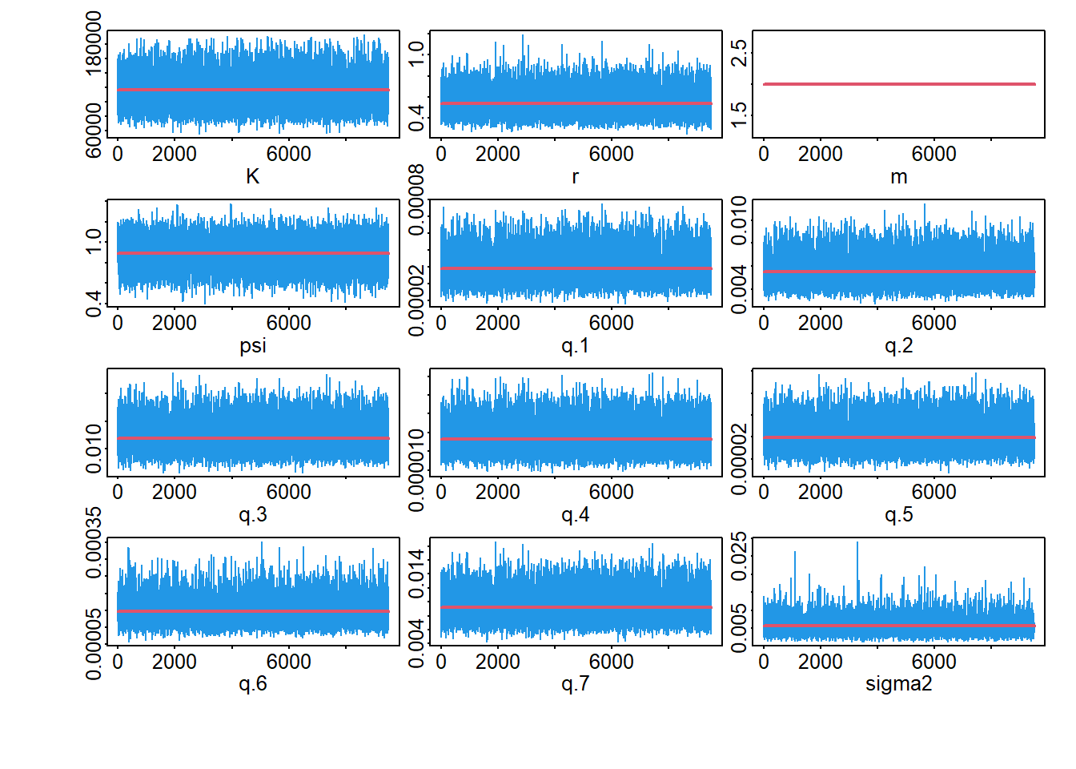
Check MCMC convergence
Should oscillate with no pattern

Slide 28
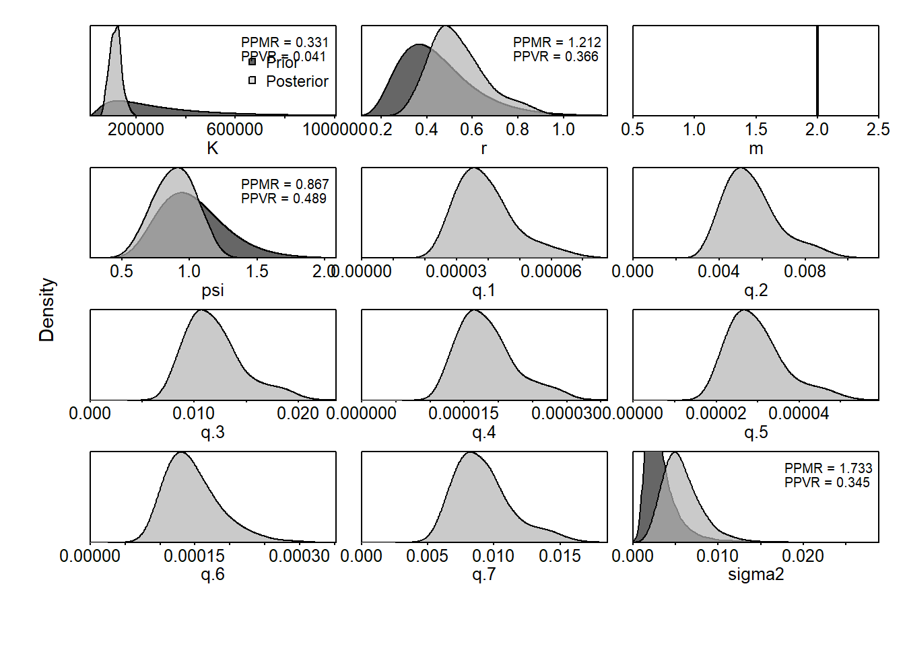
Compare prior and posterior
Should look smooth
Notice the difference between prior and posterior

Slide 29
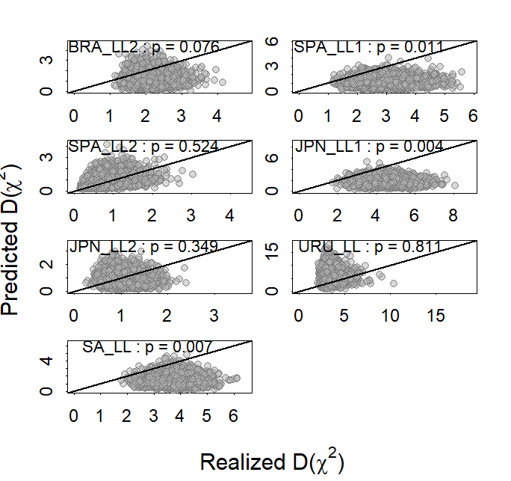
Posterior predictive checks
Compares squared standardized residuals (Realized) to the same from data simulated from the model (Predicted).
Should be even spread around line, with the fraction of points above the line p=0.5

Slide 30
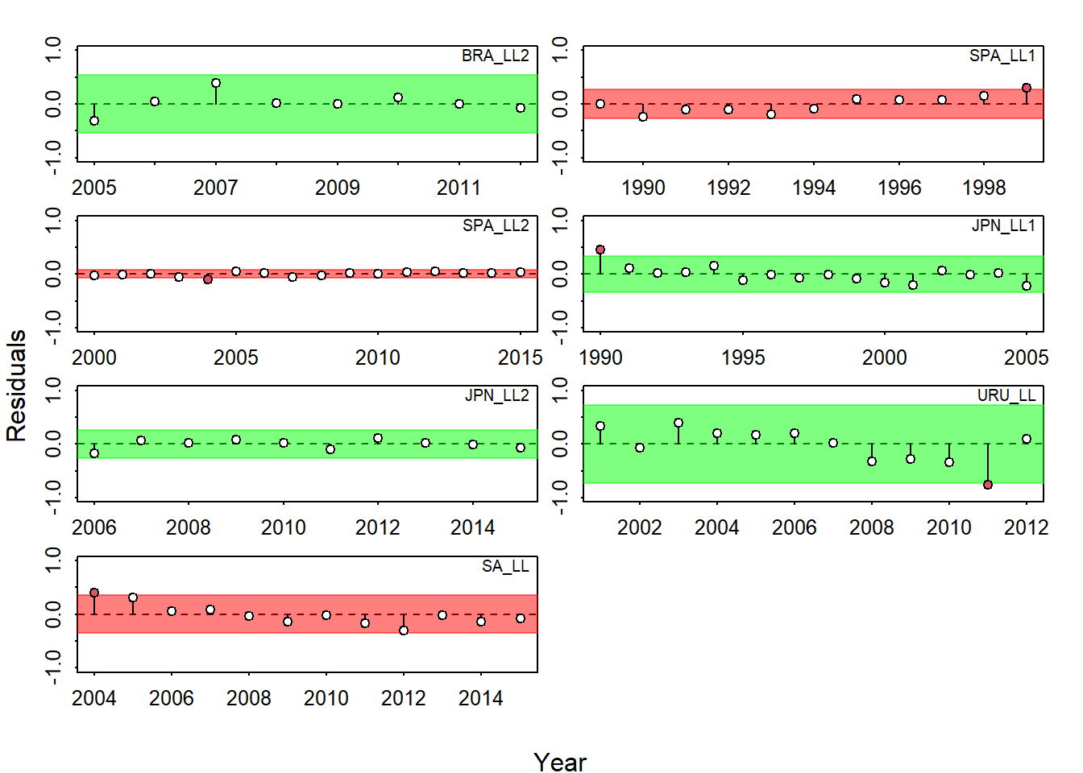
Runs test on residuals
Checks for patterns or outliers in residuals.
Green is good

Slide 31
Retrospective analysis
Re-fit the model ending, 1 year earlier, 2 years earlier, etc. Look for consistent trends
Sometimes assessments will consistently over or underestimate current biomass, biasing management advice.

Slide 32
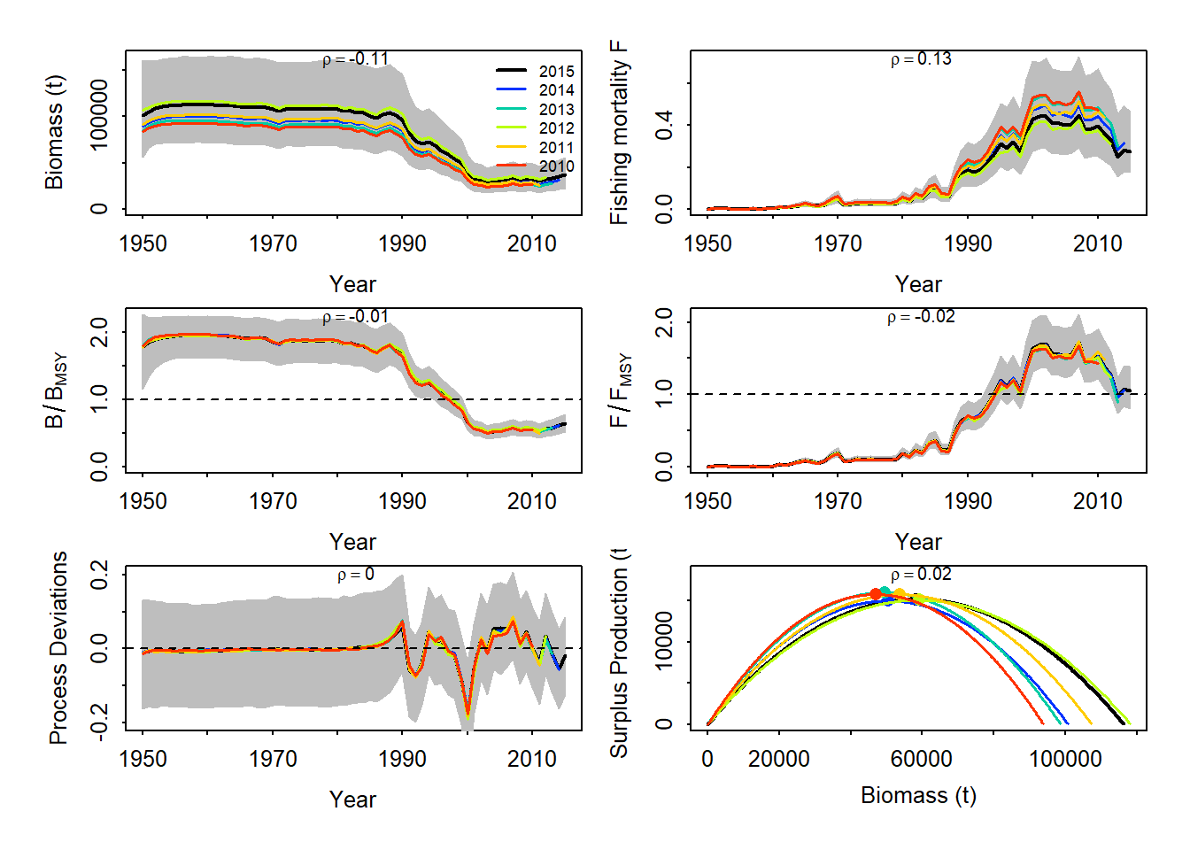
Retrospective (back 1-5 years)
No red flags

Slide 33
Hindcast cross-validation
Cross-validation means
Fit the model to only some of the data (training data)
Use the model to predict the left out data (test data)
Calculate how well model predicts the test data
Hindcast cross validation predicts last 1-5 years of CPUE from the data up to the previous year (same runs as retrospective)

Slide 34
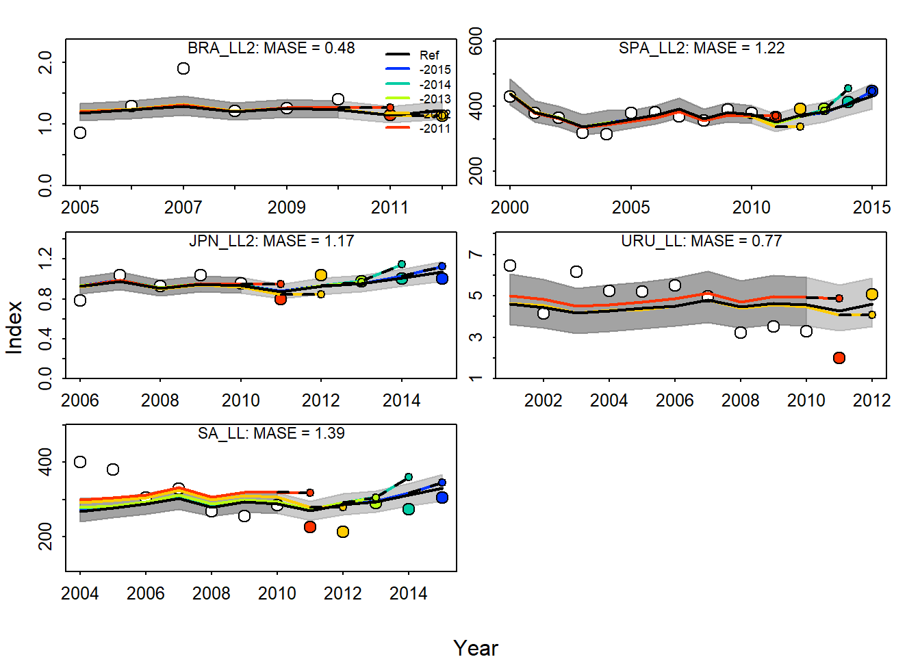
Hindcast cross-validation
Lines are predictions, circles are real CPUE data
No obvious patterns

Slide 35
Kobe plot

Slide 37
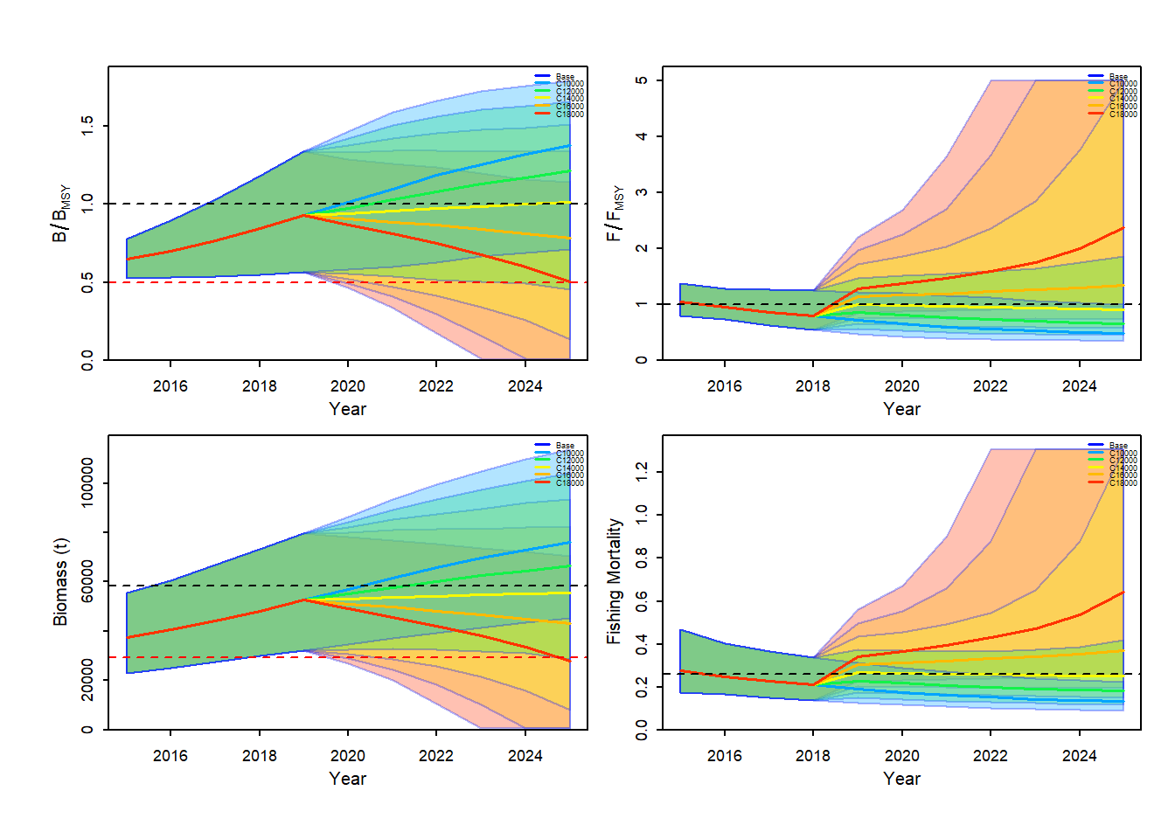
Projections

Slide 38
Pella model
The Pella Tomlinson model allows for the shape of the yield curve to be asymmetric. Bmsy/K is either fixed or an estimated parameter
Commonly used in assessment because it is more flexible.

Slide 39
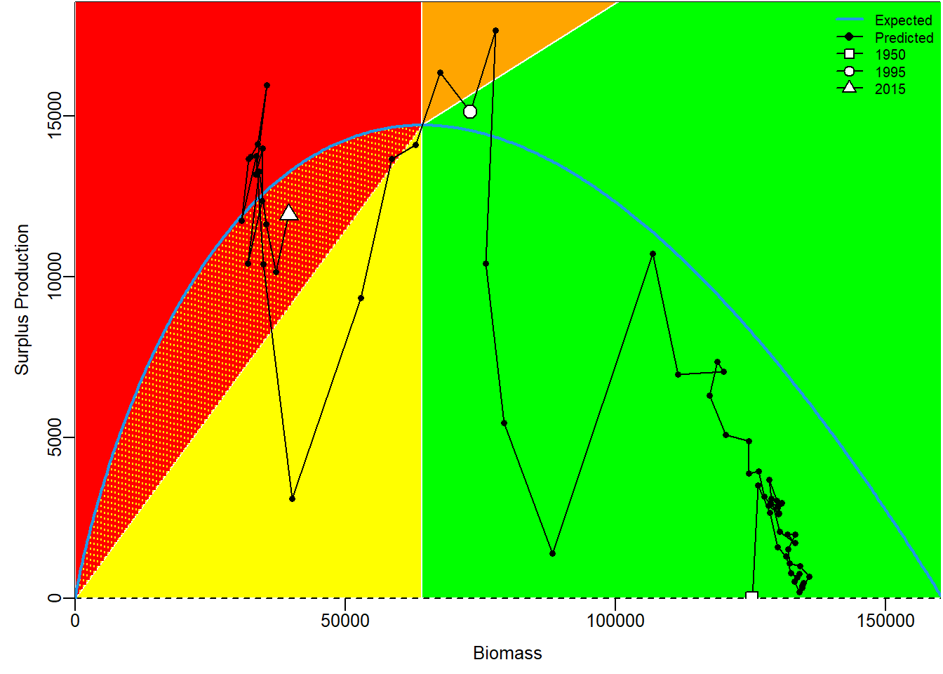
Pella yield curve

Slide 40
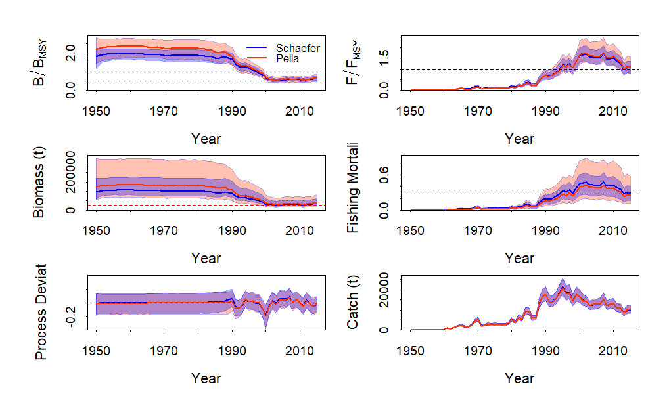
Pella vs. Schaefer

